Slide 1

Lesson 1:
Line Equation

Slide 2


Introduction

Slide 3

Lecture Overview:
Goals of the lecture:
Understand the Line Equation

Slide 4
Line Equation

Slide 5
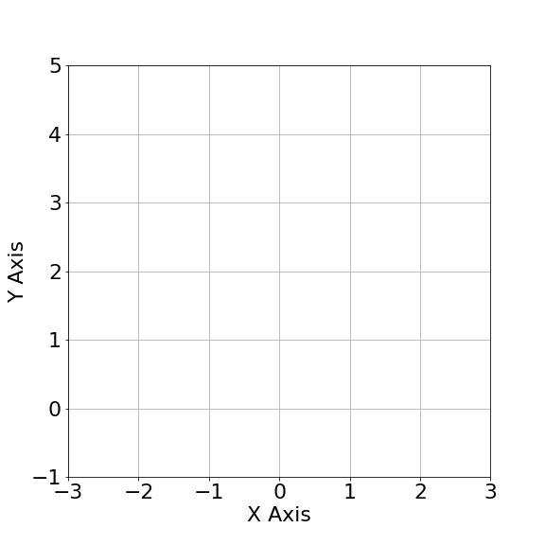
Coordinates in 2 Dimensions
p1 = (1,3)

Slide 6
Coordinates in 2 Dimensions
p1 = (1,3)
p2 = (2,5)

Slide 7
Coordinates in 2 Dimensions
p1 = (1,3)
p2 = (2,5)

Slide 8

Line Equation
p1 = (1,3)
p2 = (2,5)
$$y=mx+b$$

Slide 9

Line Equation
p1 = (1,3)
p2 = (2,5)
$$y=mx+b$$
$$y=2x+1$$

Slide 10

Line Equation
p1 = (1,3)
p2 = (2,5)
$$y=mx+b$$
$$y=2x+1$$
$$y=2∙1+1=3$$

Slide 11

Line Equation
p1 = (1,3)
p2 = (2,5)
$$y=mx+b$$
$$y=2x+1$$
$$y=2∙1+1=3$$
$$y=2∙2+1=5$$

Slide 12

What is “b”?
“b” a.k.a. intercept:
Point where a line crosses the y-axis
$$y=mx+b$$
$$y=2x+1$$

Slide 13
What is “b”?
“b” a.k.a. intercept:
Point where a line crosses the y-axis
$$y=mx+b$$
$$y=2x+1$$

Slide 14
What is “b”?
“b” a.k.a. intercept:
Point where a line crosses the y-axis
$$y=mx+b$$
$$y=2x+1$$

Slide 15

What is “m”?
“m” a.k.a. slope:
Indicates how steep the line is
$$y=mx+b$$
$$y=2x+1$$

Slide 16

What is “m”?
p2
“m” a.k.a. slope:
Indicates how steep the line is
p1
$$m=\frac{\left(y_{2}−y_{1}\right)}{\left(x_{2}−x_{1}\right)}$$

Slide 17

What is “m”?
p2
“m” a.k.a. slope:
Indicates how steep the line is
p1
y2 –y1
$$m=\frac{\left(y_{2}−y_{1}\right)}{\left(x_{2}−x_{1}\right)}$$

Slide 18

What is “m”?
p2
“m” a.k.a. slope:
Indicates how steep the line is
p1
y2 –y1
$$m=\frac{\left(y_{2}−y_{1}\right)}{\left(x_{2}−x_{1}\right)}$$
x2 –x1

Slide 19
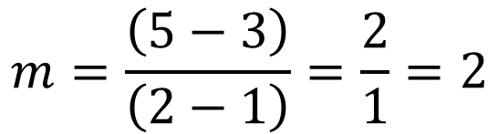
What is “m”?
p2
“m” a.k.a. slope:
Indicates how steep the line is
p1
$$m=\frac{\left(y_{2}−y_{1}\right)}{\left(x_{2}−x_{1}\right)}$$
$$m=\frac{\left(5−3\right)}{\left(2−1\right)}=\frac{2}{1}=2$$

Slide 20

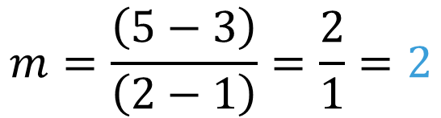
What is “m”?
p2
“m” a.k.a. slope:
Indicates how steep the line is
p1
$$m=\frac{\left(y_{2}−y_{1}\right)}{\left(x_{2}−x_{1}\right)}$$
$$m=\frac{\left(5−3\right)}{\left(2−1\right)}=\frac{2}{1}=2$$
$$y=2x+1$$

Slide 21
What is “m”?
“m” a.k.a. slope:
Indicates how steep the line is
$$m=\frac{\left(y_{2}−y_{1}\right)}{\left(x_{2}−x_{1}\right)}$$
p2
p1

Slide 22
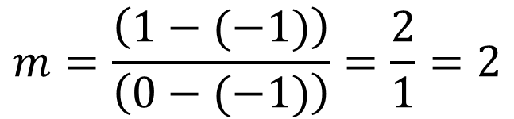
What is “m”?
“m” a.k.a. slope:
Indicates how steep the line is
$$m=\frac{\left(y_{2}−y_{1}\right)}{\left(x_{2}−x_{1}\right)}$$
p2
$$m=\frac{\left(1−(−1)\right)}{\left(0−(−1)\right)}=\frac{2}{1}=2$$
p1

Slide 23
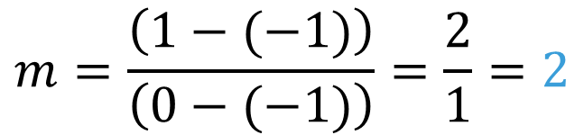
What is “m”?
“m” a.k.a. slope:
Indicates how steep the line is
$$m=\frac{\left(y_{2}−y_{1}\right)}{\left(x_{2}−x_{1}\right)}$$
p2
$$m=\frac{\left(1−(−1)\right)}{\left(0−(−1)\right)}=\frac{2}{1}=2$$
p1
$$y=2x+1$$

Slide 24
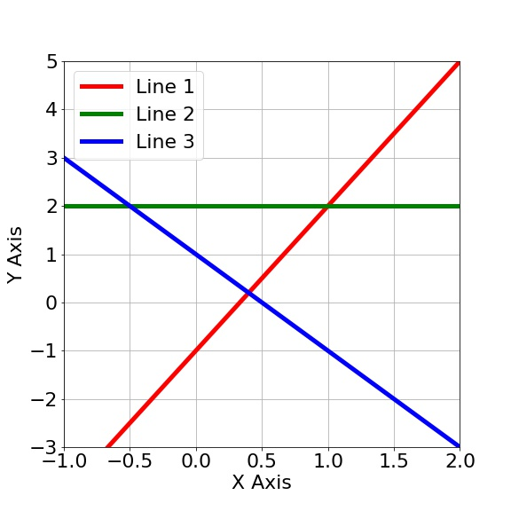


Problem 1:
Calculate the line equation for the following lines. Helper equations:
Problem 1:
$$y=mx+b$$
$$m=\frac{\left(y_{2}−y_{1}\right)}{\left(x_{2}−x_{1}\right)}$$

Slide 25

Problem 1:
Let’s first extract the intercept:
$$y=mx+b=mx−1$$
$$y=mx+b=mx+2$$
$$y=mx+b=mx+1$$

Slide 26
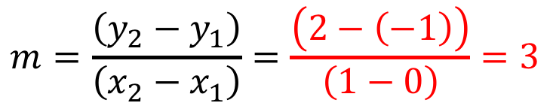

Exercise
Let’s extract the slope:
$$y=mx+b=3x−1$$
$$y=mx+b=mx+2$$
$$y=mx+b=mx+1$$
$$m=\frac{\left(y_{2}−y_{1}\right)}{\left(x_{2}−x_{1}\right)}=\frac{\left(2−\left(−1\right)\right)}{\left(1−0\right)}=3$$

Slide 27
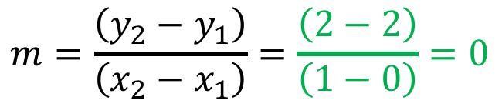

Exercise
Let’s extract the slope:
$$y=mx+b=3x−1$$
$$y=mx+b=2$$
$$y=mx+b=mx+1$$
$$m=\frac{\left(y_{2}−y_{1}\right)}{\left(x_{2}−x_{1}\right)}=\frac{\left(2−2\right)}{\left(1−0\right)}=0$$

Slide 28
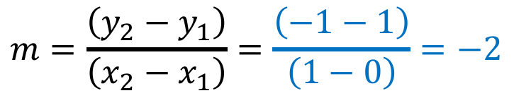

Exercise
Let’s extract the slope:
$$y=mx+b=3x−1$$
$$y=mx+b=2$$
$$y=mx+b=−2x+1$$
$$m=\frac{\left(y_{2}−y_{1}\right)}{\left(x_{2}−x_{1}\right)}=\frac{\left(−1−1\right)}{\left(1−0\right)}=−2$$

Slide 29
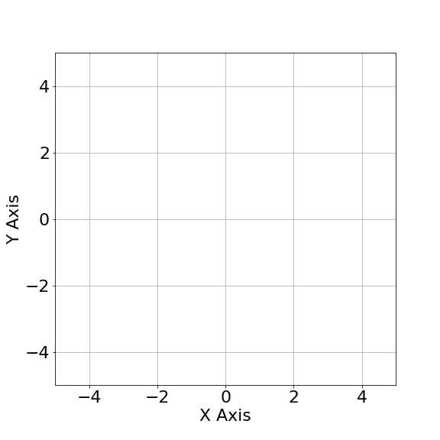

A few observations
Parallel lines have the same slope, but different intercept.
$$y=1x+2$$
$$y=1x−2$$

Slide 30

A few observations
Lines that cross the y-axis at the same point have the same intercept, but different slope.
$$y=1x+2$$
$$y=−1x+2$$

Slide 31
A few observations
All these lines have positive slope.

Slide 32
A few observations
All these lines have negative slope.

Slide 33
A few observations
These lines have a slope of 0.

Slide 34
A few observations
These lines have a slope of infinity.

Slide 35
Derivatives

Slide 36
Derivatives
Derivative = Slope

Slide 37
QUESTIONS?

